Slide 1

Part-of-Speech-Tagging and Sequence Labeling
Michael Kamp
Notes:
"Did you know that understanding the structure of a sentence is crucial for computers to comprehend human language?"

Slide 2
Objectives and Learning Outcomes
Objectives
introduce core concepts of part-of-speech (POS) tagging and sequence labeling
familiarize with key algorithms
engage through practical application

Slide 3
Objectives and Learning Outcomes
Objectives
introduce core concepts of part-of-speech (POS) tagging and sequence labeling
familiarize with key algorithms
engage through practical application
Learning Outcomes:
understanding key concepts and their significance in natural language processing (NLP)
being able to compare and contrast traditional methods and deep-learning-based methods
being able to apply pre-trained NLP models and analyze the results

Slide 4



Sequence Labeling
Supervised Learning:
instances and label
learn function
[1]

Slide 5






Sequence Labeling
Supervised Learning:
instances and label
learn function
[1]

Slide 6




Sequence Labeling
Supervised Learning:
instances and label
learn function
Sequence Labeling:
: tokens , : space of all sequences over
: set of labels, : set of all sequences over
[1]

Slide 7
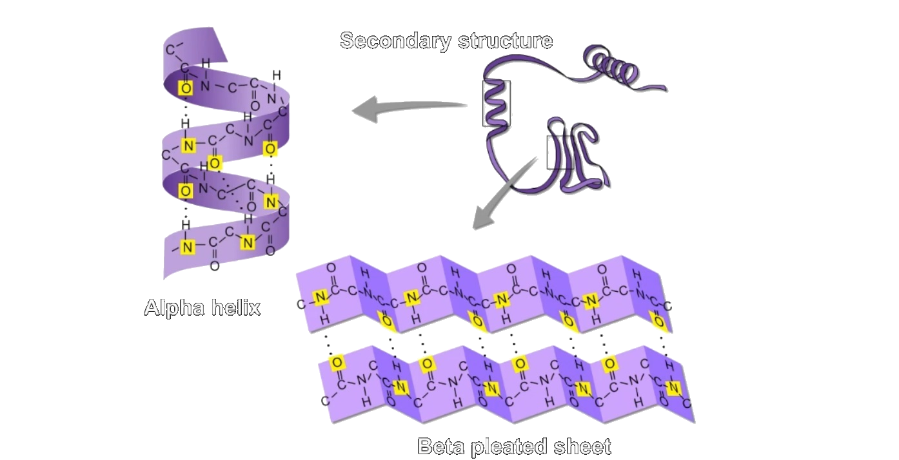
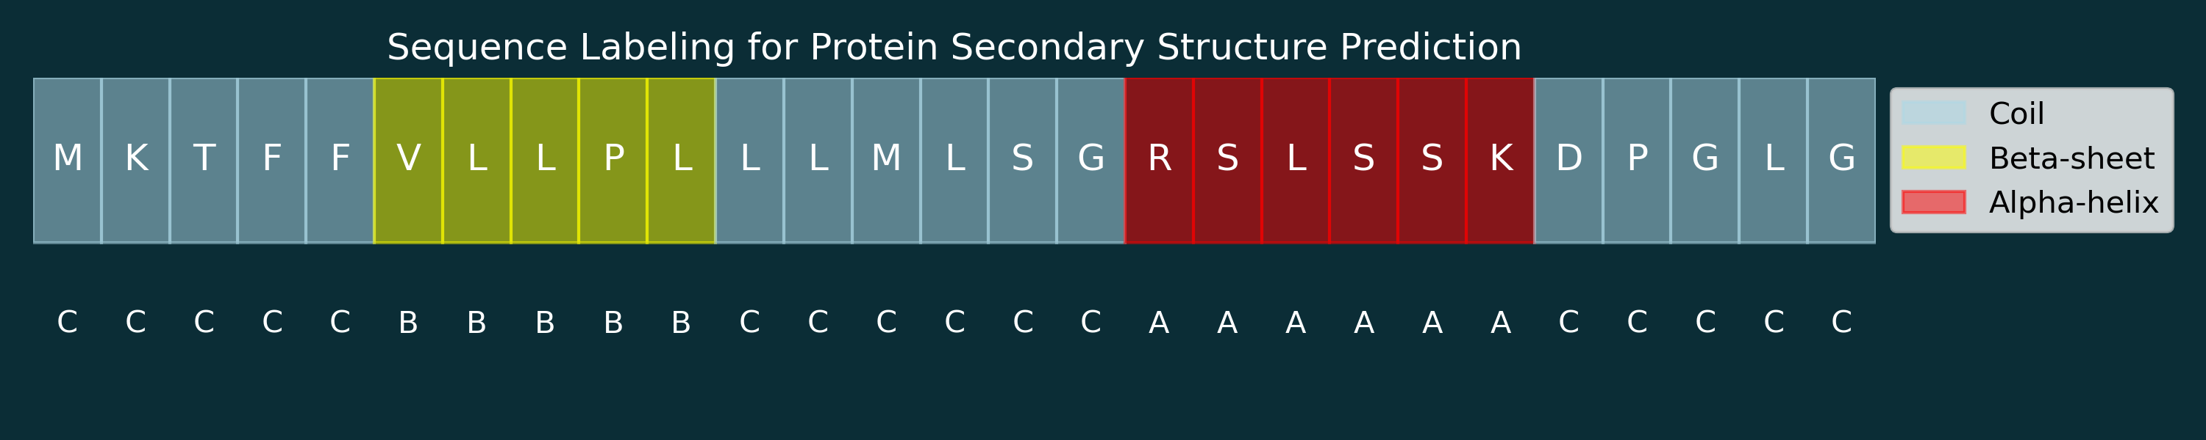


Sequence Labeling
Supervised Learning:
instances and label
learn function
Sequence Labeling:
: tokens , : space of all sequences over
: set of labels, : set of all sequences over
Example 1:
[1]
[2]
FACTS.NET 2023

Slide 8



Sequence Labeling
Supervised Learning:
instances and label
learn function
Sequence Labeling:
: tokens , : space of all sequences over
: set of labels, : set of all sequences over
Example 2:
[1]
[4]

Slide 9



Sequence Labeling:
Part-of-Speech Tagging
Part-of-Speech (POS) Tagging:
: set of all possible words , : space of all sentences over
: parts of speech, e.g., in English: noun, verb, article, adjective, preposition, …
: set of all tuples of parts of speech
: a sentence , : tags for each word in
[3]

Slide 10
Sequence Labeling:
Part-of-Speech Tagging
Part-of-Speech (POS) Tagging Example Applications:
Analyze syntax of sentences to improve text generation.
Improve queries in search engines by identifying important words in search queries.
Help in Named Entity Recognition to find out whether Apple refers to the fruit or the company.
Improve machine translation, particularly for languages with gendered nouns or complex verb forms.

Slide 11
Key Algorithms

Slide 12
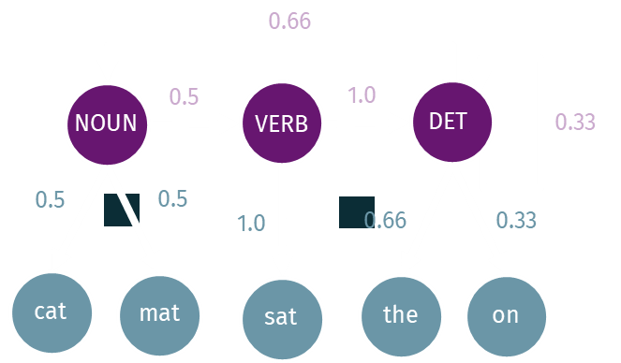
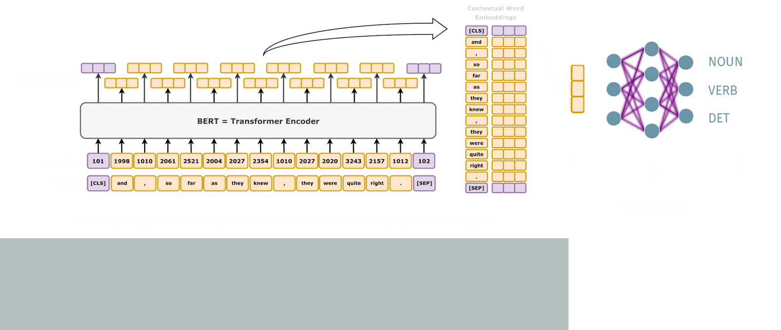
Key Algorithms
Traditional Methods
Rule-Based Algorithms
Hidden Markov Modells
Neural-Network-Based Approaches
Long-Short-Term-Memory (LSTM)
Transformer-Based Approaches

Slide 13
Traditional Methods

Slide 14
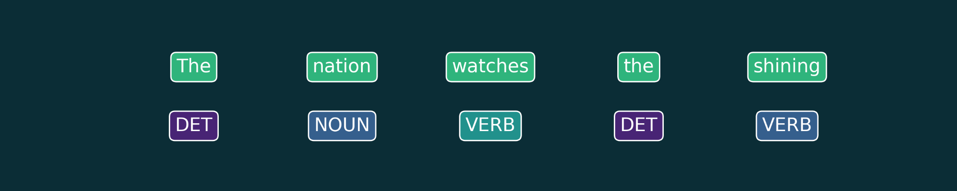
Rule-Based Approaches
define set of rules, e.g.,
1. assign NOUN if ( word ends in –tion ) or ( word ends in –ment )
2. assign VERB if ( word ends in –ing ) or ( word ends in –es )
example: nation is NOUN (rule 1), running is VERB (rule 2), instalment is NOUN (rule 1)

Slide 15

Rule-Based Approaches
define set of rules, e.g.,
1. assign NOUN if ( word ends in –tion ) or ( word ends in –ment )
2. assign VERB if ( word ends in –ing )
example: nation is NOUN (rule 1), running is VERB (rule 2), instalment is NOUN (rule 1)
add more complex rules that transform tags, e.g.,
3. change tag to NOUN if tag is VERB and word before is DET
example: the shining is VERB (rule 2), VERB is changed to NOUN (rule 3)

Slide 16
Rule-Based Approaches
define set of rules, e.g.,
1. assign NOUN if ( word ends in –tion ) or ( word ends in –ment )
2. assign VERB if ( word ends in –ing )
example: nation is NOUN (rule 1), running is VERB (rule 2), instalment is NOUN (rule 1)
add more complex rules that transform tags, e.g.,
3. change tag to NOUN if tag is VERB and word before is DET
example: the shining is VERB (rule 2), VERB is changed to NOUN (rule 3)
Problems:
ambiguity: the address and to address
rules have to be consistent, i.e., no two rules may apply (difficult to verify for complex rule systems)
difficult to infer rule systems from data

Slide 17





Hidden Markov Models
POS-tags are hidden states of a system with initial state distribution
hidden states emit words with certain probabilities
hidden states transition into other states with certain probabilities
Notes:
Emission matrix and transition matrix

Slide 18

Hidden Markov Models
POS-tags are hidden states of a system with initial state distribution
hidden states emit words with certain probabilities
hidden states transition into other states with certain probabilities
words in sequence are observations
The cat sat on the mat.
0.66
0.5
1.0
NOUN
VERB
DET
0.33
0.5
0.5
1.0
0.66
0.33
cat
mat
sat
the
on
Notes:
Emission matrix and transition matrix

Slide 19
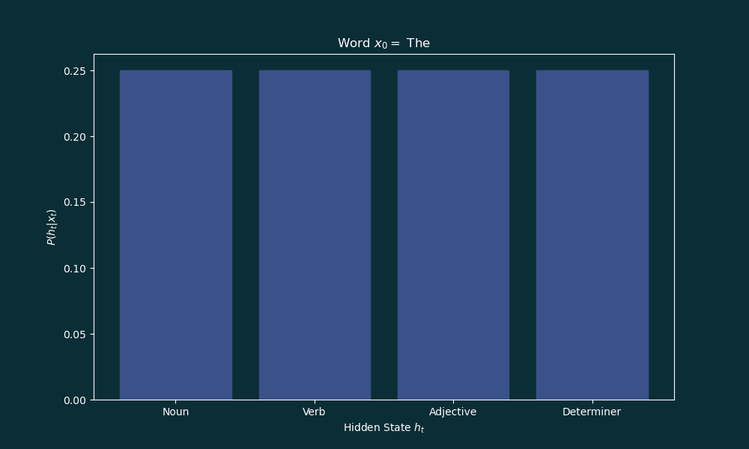
Hidden Markov Models
POS-tags are hidden states of a system with initial state distribution
hidden states emit words with certain probabilities
hidden states transition into other states with certain probabilities
words in sequence are observations
find sequence of hidden states that maximes probability of observations (Viterbi algorithm)
The cat sat on the mat.
0.66
0.5
1.0
NOUN
VERB
DET
0.33
0.5
0.5
1.0
0.66
0.33
cat
mat
sat
the
on
Notes:
Emission matrix and transition matrix

Slide 20
Neural-Network-Based Approaches

Slide 21


Long-Short-Term-Memory (LSTM)
[6]
Idea:
input sequence is fed element by element into the LSTM
LSTM has a hidden state that can be translated to an output
LSTM has an internal memory, or cell state
Recurrent Neural Network
Notes:
[6] Hochreiter and Schmidhuber "Long Short-term Memory." Neural Computation MIT-Press (1997).

Slide 22


Long-Short-Term-Memory (LSTM)
Idea:
input sequence is fed element by element into the LSTM
LSTM has a hidden state that can be translated to an output
LSTM has an internal memory, or cell state
Recurrent Neural Network
Unfold as Feed-Forward-Network
=

Slide 23
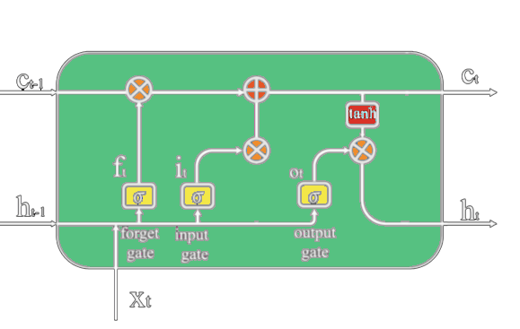









Long-Short-Term-Memory (LSTM)
LSTM Cell
input
hidden state and cell state
input gate , output gate , and forget gate
, , and are functions of and
is a function of , , and
is a function of and
From Figure 6 in Luo et al., 2021 [1]

Slide 24
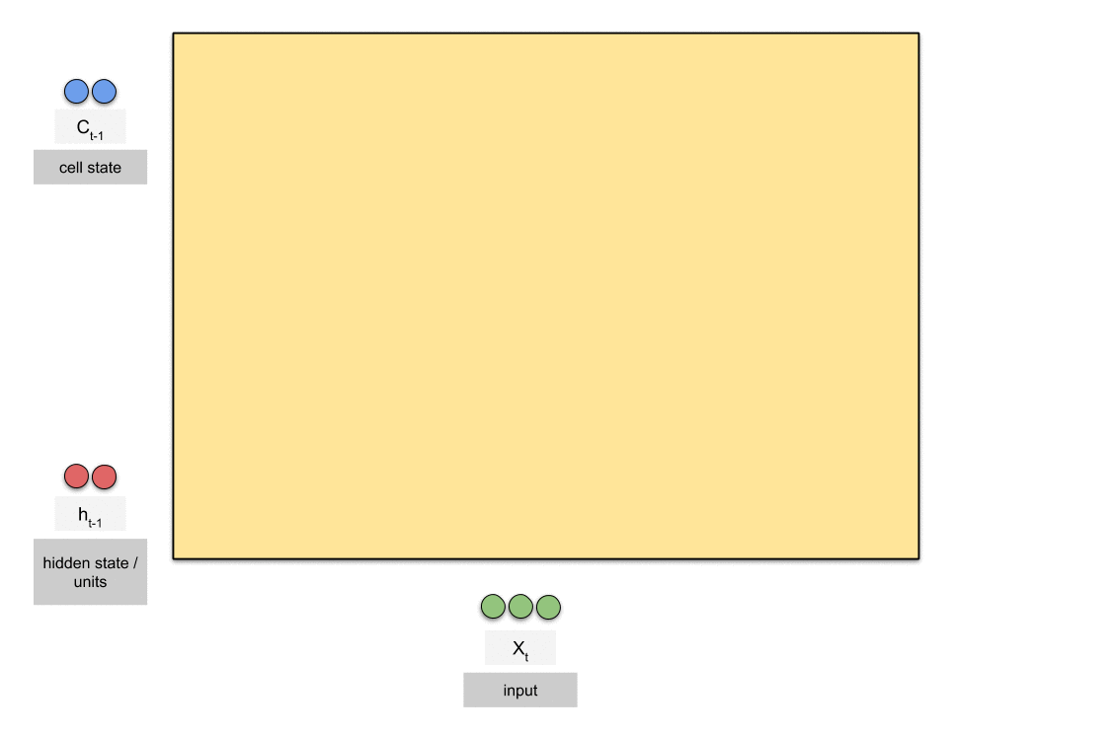
Long-Short-Term-Memory (LSTM)
Raimi Karim. "Animated RNN, LSTM and GRU." towardsdatasciene.com, 2018.

Slide 25
Long-Short-Term-Memory (LSTM)
Raimi Karim. "Animated RNN, LSTM and GRU." towardsdatasciene.com, 2018.

Slide 26
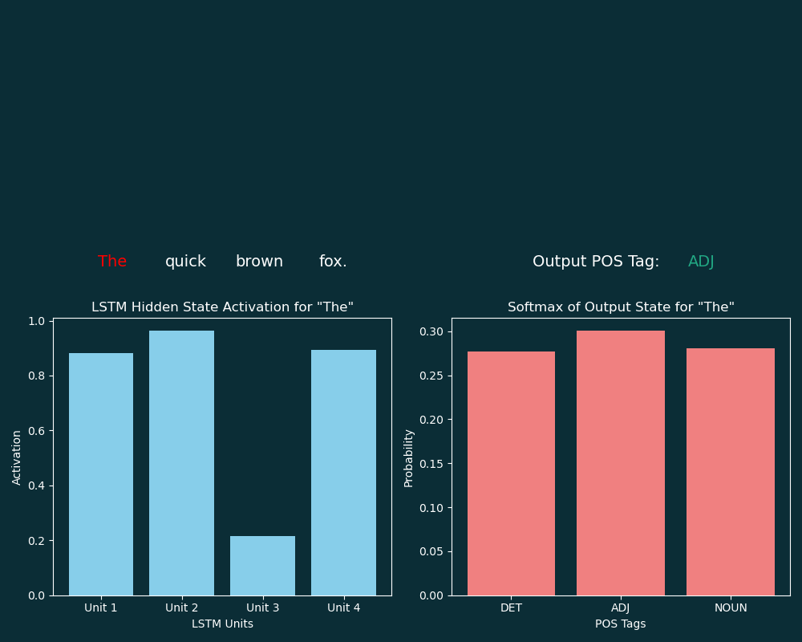
Long-Short-Term-Memory (LSTM)
output is a function of , typically a linear layer and softmax

Slide 27
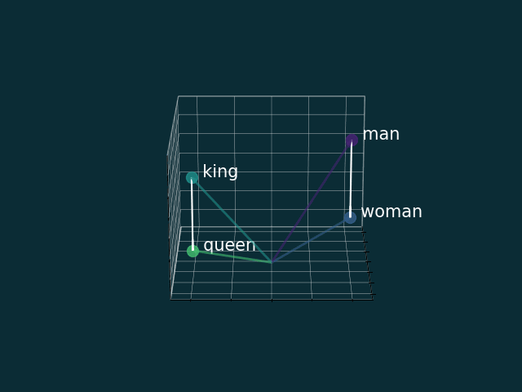
Transformer-Based Approaches
[7]
Idea:
word embeddings:
Notes:
Vaswani, Ashish. "Attention is all you need." Advances in Neural Information Processing Systems (2017).

Slide 28

Transformer-Based Approaches
[7]
Idea:
word embeddings:
Notes:
Vaswani, Ashish. "Attention is all you need." Advances in Neural Information Processing Systems (2017).

Slide 29

Transformer-Based Approaches
[7]
Idea:
word embeddings:
positional embedding:
I
am
Groot
0
1
2
Notes:
Vaswani, Ashish. "Attention is all you need." Advances in Neural Information Processing Systems (2017).

Slide 30


Transformer-Based Approaches
[7]
Idea:
word embeddings:
positional embedding:
I
am
Groot
0
1
2
0 | 1 | 0 | 1
0.84 | 0.54 | 0.10 | 1.0
0.91 | -0.42 | .020 | 0.98
Notes:
Vaswani, Ashish. "Attention is all you need." Advances in Neural Information Processing Systems (2017).

Slide 31


Transformer-Based Approaches
[7]
Idea:
word embeddings:
positional embedding:
I
am
Groot
0
1
2
0 | 1 | 0 | 1
0.84 | 0.54 | 0.10 | 1.0
0.91 | -0.42 | .020 | 0.98
Notes:
Vaswani, Ashish. "Attention is all you need." Advances in Neural Information Processing Systems (2017).

Slide 32
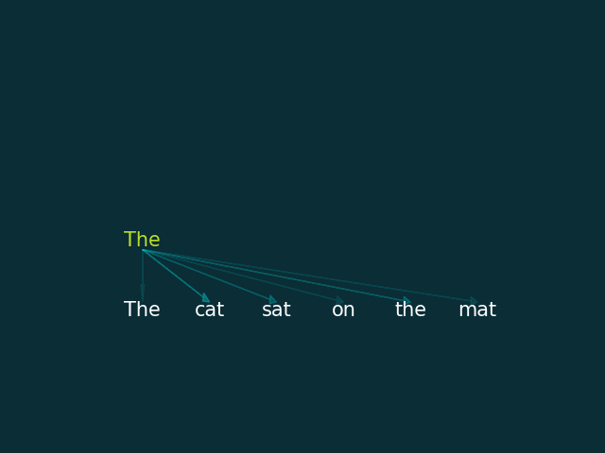
Transformer-Based Approaches
[7]
Idea:
word embeddings:
positional embedding:
attention:
I
am
Groot
0
1
2
0 | 1 | 0 | 1
0.84 | 0.54 | 0.10 | 1.0
0.91 | -0.42 | .020 | 0.98
Notes:
Vaswani, Ashish. "Attention is all you need." Advances in Neural Information Processing Systems (2017).

Slide 33










Transformer-Based Approaches
[7]
Transformer Block:
 |  | The | cat | sat | on | the | mat
The |  | 0.00 | 0.00 | 0.00 | 0.00 | 0.00 | 0.00
cat |  | 0.99 | 0.00 | 0.42 | 0.00 | 0.00 | 0.31
sat |  | 0.01 | 0.51 | 0.00 | 0.00 | 0.00 | 0.69
on |  | 0.00 | 0.00 | 0.00 | 0.00 | 0.00 | 0.00
the |  | 0.00 | 0.00 | 0.00 | 0.00 | 0.00 | 0.00
mat |  | 0.00 | 0.49 | 0.58 | 1.00 | 1.00 | 0.00
queries
key
Notes:
Normalized using softmax

Slide 34

Transformer-Based Approaches
[7]
Transformer Block:
 |  | The | cat | sat | on | the | mat
The |  | 0.00 | 0.00 | 0.00 | 0.00 | 0.00 | 0.00
cat |  | 0.99 | 0.00 | 0.62 | 0.00 | 0.00 | 0.31
sat |  | 0.01 | 0.51 | 0.00 | 0.00 | 0.00 | 0.69
on |  | 0.00 | 0.00 | 0.00 | 0.00 | 0.00 | 0.00
the |  | 0.00 | 0.00 | 0.00 | 0.00 | 0.00 | 0.00
mat |  | 0.00 | 0.49 | 0.38 | 1.00 | 1.00 | 0.00
queries
Any nouns close by?
key
Notes:
Normalized using softmax

Slide 35

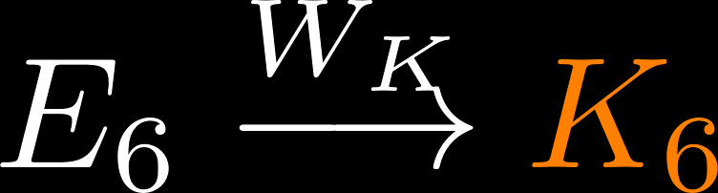
Transformer-Based Approaches
[7]
Transformer Block:
 |  | The | cat | sat | on | the | mat
The |  | 0.00 | 0.00 | 0.00 | 0.00 | 0.00 | 0.00
cat |  | 0.99 | 0.00 | 0.62 | 0.00 | 0.00 | 0.31
sat |  | 0.01 | 0.51 | 0.00 | 0.00 | 0.00 | 0.69
on |  | 0.00 | 0.00 | 0.00 | 0.00 | 0.00 | 0.00
the |  | 0.00 | 0.00 | 0.00 | 0.00 | 0.00 | 0.00
mat |  | 0.00 | 0.49 | 0.38 | 1.00 | 1.00 | 0.00
queries
Any nouns close by?
I am a noun!
I am a noun!
key
Credit to 3Blue1Brown for the idea of this visualization.
Notes:
Normalized using softmax

Slide 36
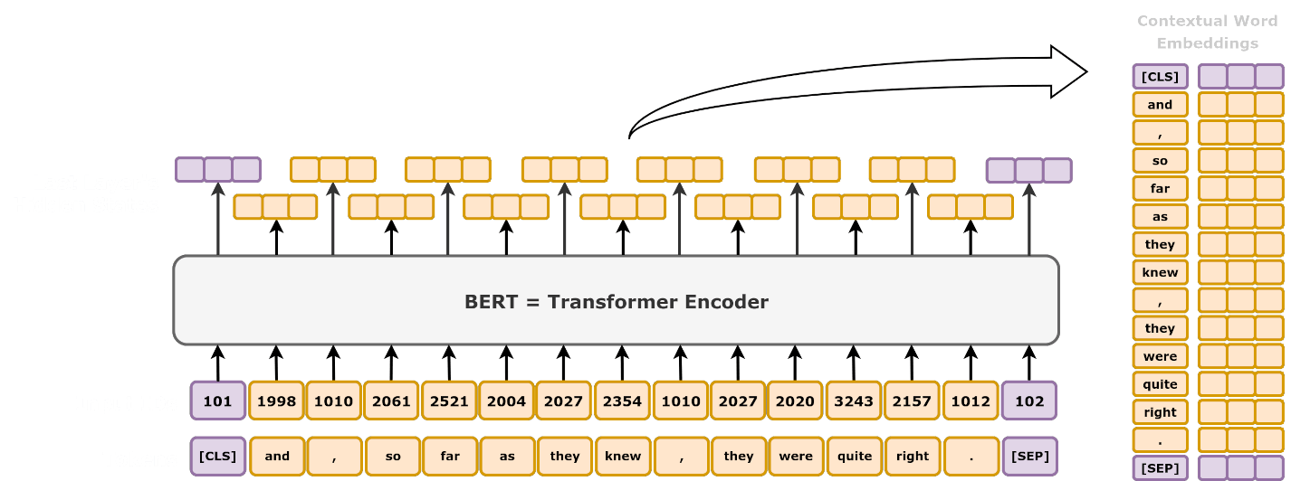
Transformer-Based Approaches
Bidirectional Encoder Representations from Transformers (BERT):
Daniel Voigt Godoy, BERT: Pre-training of Deep Bidirectional Transformers for Language Understanding, 2021
pretrained
Notes:
Normalized using softmax

Slide 37
Transformer-Based Approaches
Bidirectional Encoder Representations from Transformers (BERT):
NOUN
VERB
DET
trained
Daniel Voigt Godoy, BERT: Pre-training of Deep Bidirectional Transformers for Language Understanding, 2021
pretrained
Notes:
Normalized using softmax

Slide 38
Can you do it?

Slide 39
The old man the boats.
Tags:
Noun: NOUN
Verb: VERB
Determiner : DET
Adjective: ADJ

Slide 40
Let‘s see what the models can do.

Slide 41

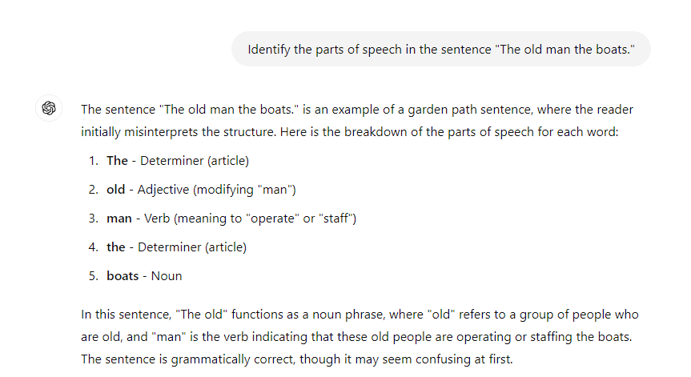

Slide 42
Q & A

Slide 43

Summary
Sequence Labeling: label each element in a sequence
Part-of-Speech Tagging: label each word in a sentence with a part-of-speech tag
Applications:
protein secondary structure prediction
anomaly detection in user interactions
part-of-speech tagging: query expansion, NER, machine translation
Traditional approaches:
Rule-Based Methods HMMs
Neural-network-based approaches:
LSTMs Transformers (BERT)

Slide 44
References
[1] Shalev-Shwartz, Shai, and Shai Ben-David. Understanding machine learning: From theory to algorithms. Cambridge university press, 2014.
[2] Jones, D. T. (1999). Protein secondary structure prediction based on position-specific scoring matrices. Journal of Molecular Biology, 292(2), 195-202.
[3] Petrov, Slav, Dipanjan Das, and Ryan McDonald. "A Universal Part-of-Speech Tagset." Proceedings of the Eighth International Conference on Language Resources and Evaluation, 2012.
[4] Adilova, Linara, and Chen, Siming, and Kamp, Michael. "Informed Novelty Detection in Sequential Data by Per-Cluster Modeling.“ Proceedings of the ICML Workshop on Artificial Intelligence & Human Computer Interaction, 2023.
[5] Luo, Junling, et al. "Time series prediction of COVID-19 transmission in America using LSTM and XGBoost algorithms." Results in Physics 27 (2021): 104462.
[6] Hochreiter, S. "Long Short-term Memory." Neural Computation MIT-Press (1997).
[7] Vaswani, A. "Attention is all you need." Advances in Neural Information Processing Systems (2017).

Slide 45
Summary
Sequence Labeling: label each element in a sequence
Part-of-Speech Tagging: label each word in a sentence with a part-of-speech tag
Applications:
protein secondary structure prediction
anomaly detection in user interactions
part-of-speech tagging: query expansion, NER, machine translation
Traditional approaches:
Rule-Based Methods HMMs
Neural-network-based approaches:
LSTMs Transformers (BERT)

Slide 47
Long-Short-Term-Memory (LSTM)
LSTM Cell
input
hidden state and cell state
input gate , output gate , and forget gate
, , and are functions of and
is a function of , , , and
is a function of and
From Figure 6 in Luo et al., 2021 [1]

